Slide 1

Computational Biology, Genetics and Epigenetics to Understand Disease Etiologies and Improve Precision Medicine
Shicheng Guo
Center for Precision Medicine Research
Marshfield Clinic Research Institute
15/05/2019

Slide 2
Outline
Background: Macro and Micro View of Human Diseases in 21 Century
Identification of genetic variation for human complex diseases
Identification of Epigenetic biomarkers for human complex diseases
Deep-learning to genetic, epigenetic and image data in precision medicine

Slide 3
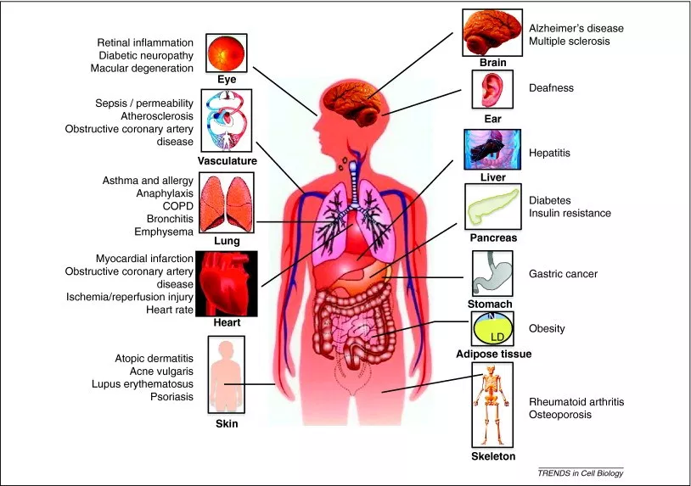
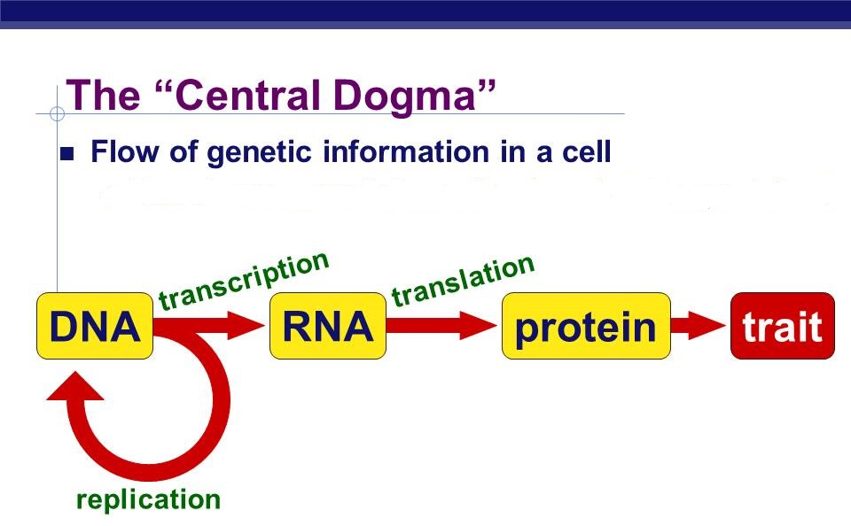
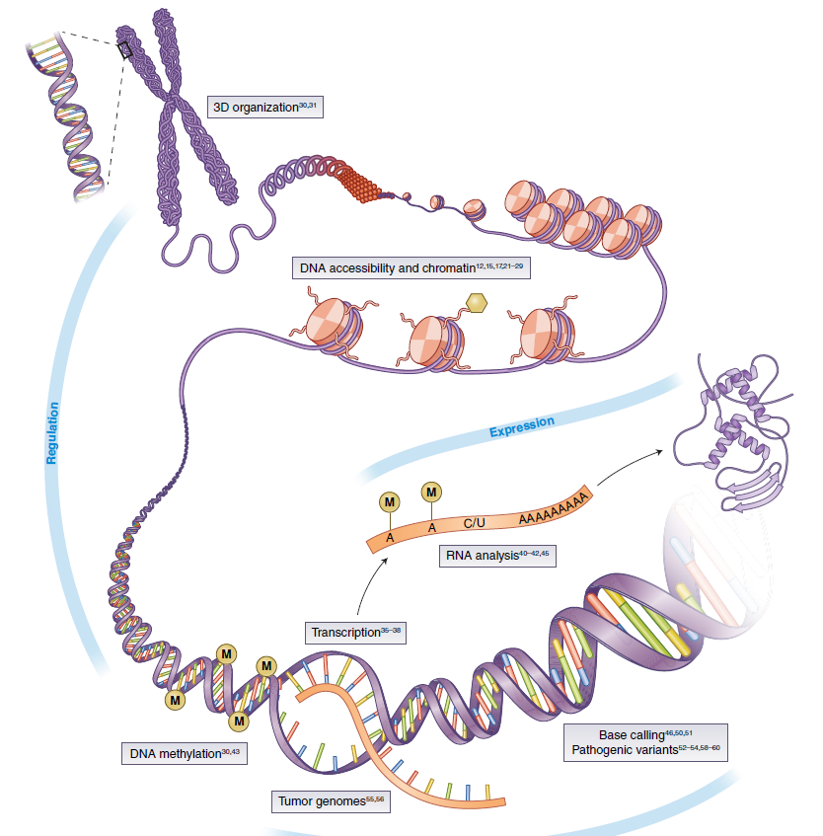
Macro and Micro View of Human Diseases in 21 Century
DNA/RNA/Protein Modification
~80 different types of autoimmune diseases
~100 different types of human cancers
~ 7,000 rare diseases
~ 12,420 total diseases (WHO, 2011)

Slide 4
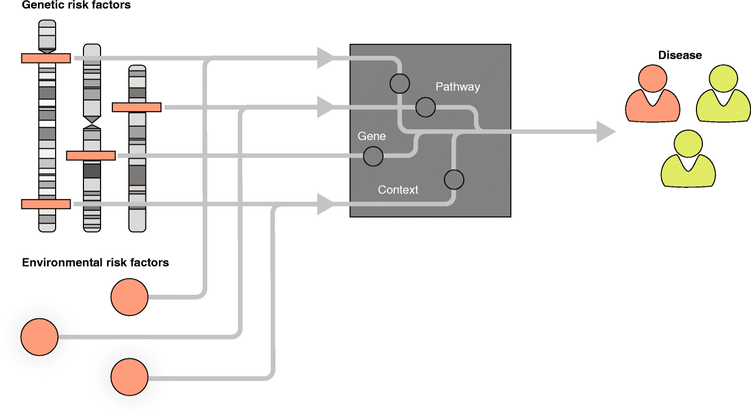
Computational Frame for Disease Etiology and Pathologies Research
Genetic risk factors
Clinical Phenotypes
Weeks
Years
Network
Pathological phenotypes
Image phenotypes
Environmental risk factors
Epigenetics risk factors
Electroencephalography (EEG)
Positron Emission Tomography (PET)
Magnetic Resonance Imaging (MRI)
Lifestyle risk factors

Slide 5
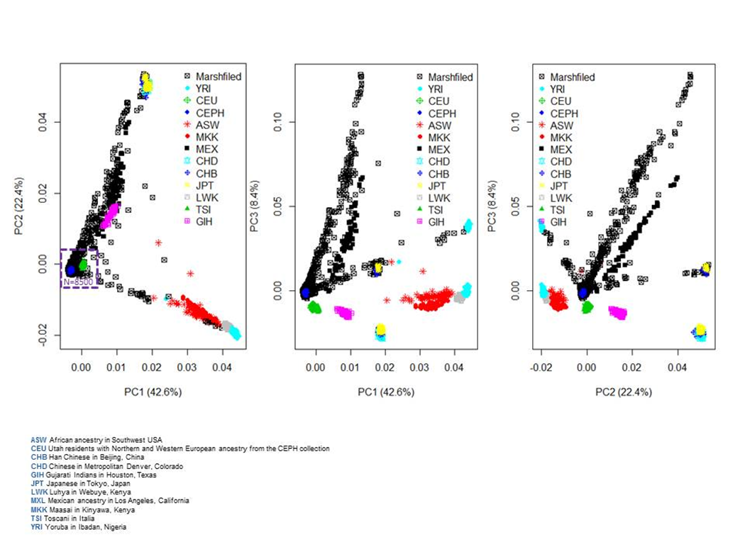

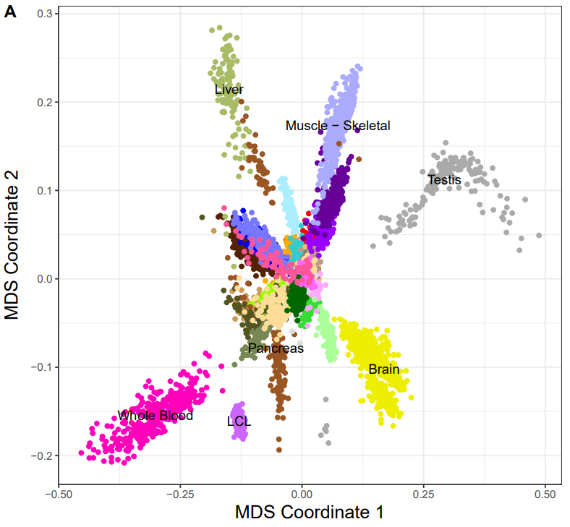
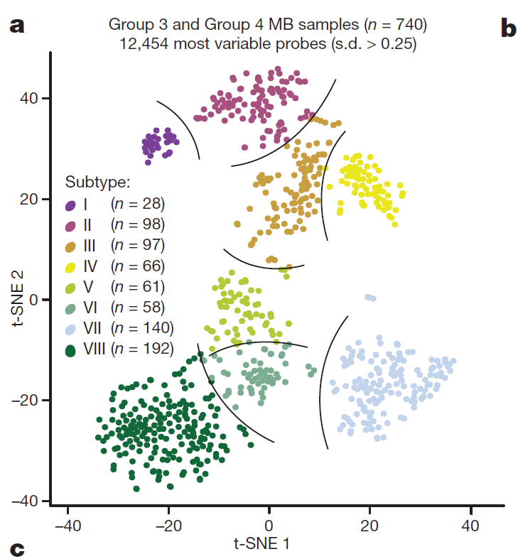
Individual, Tissue and Subtype Identification with Genomic Data
CoreExome Beadchip Genome-wide RNA-Seq data
Genome-wide DNA methylation data
Asian
Brain cancer
European
African
Brain
Unpublished data, Guo, Schrodi, 2019
Modified, Nature, 2017; 550 (7675): 204
Modified, Nature, 2017; 547 (7663): 314

Slide 6
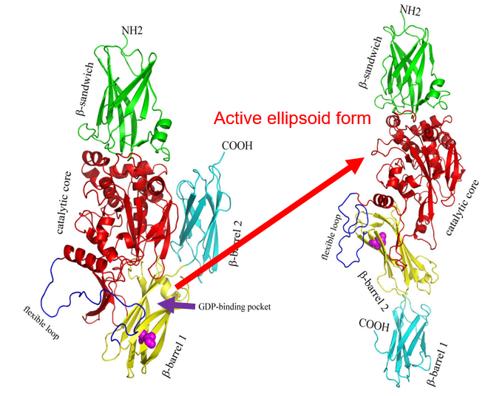
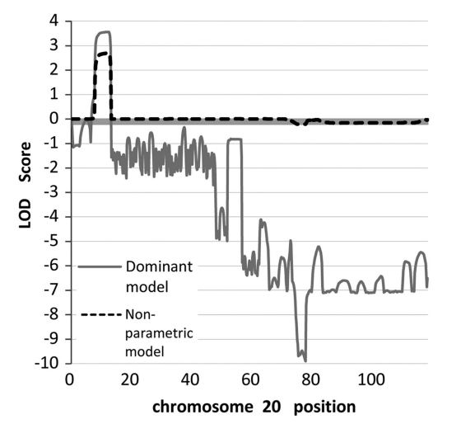
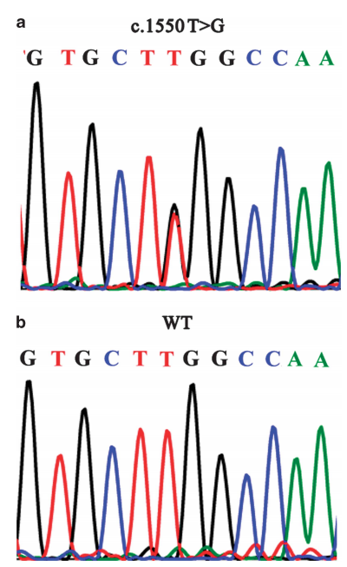
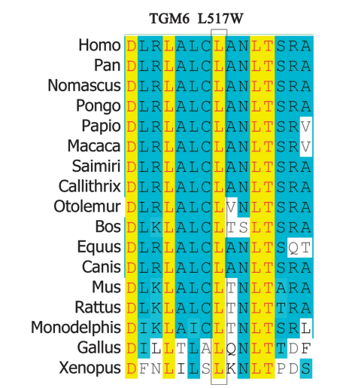
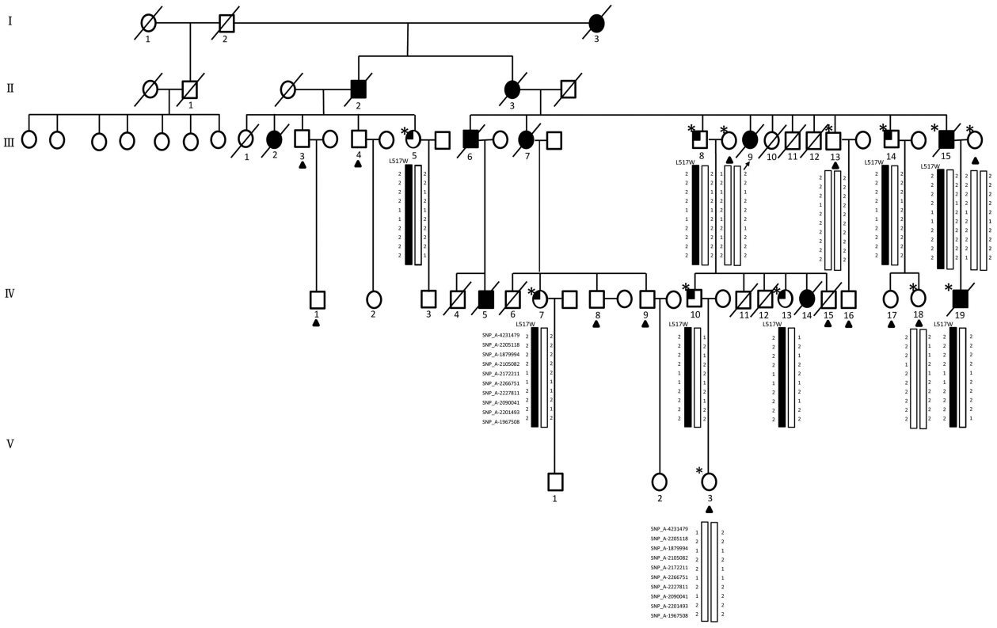
Linkage analysis to identify acute myeloid leukemia (AML) genes: TGM6
20p13
LOD: Logarithm of ODds
Autosomal-dominant AML family with 11 cases in four generations
Linkage analysis and targeted next-generation sequencing (NGS)
2 exonic variants (TGM6 and CENPB), 15 intronic, 15 intergenic and 4 UTR variants
TGM6: occurred in 2 patients and 6 members at potential pre-leukaemic phase, but not in 13 unaffected individuals and 530 ethnically matched healthy controls
Mutation might make TGM6 have strong GDP-binding ability and easy to transfer to active form.
Pan, .. ,Guo, Zhang, Huang, Lin, Wang. European Journal of Human Genetics (2015) 23, 218–223

Slide 7
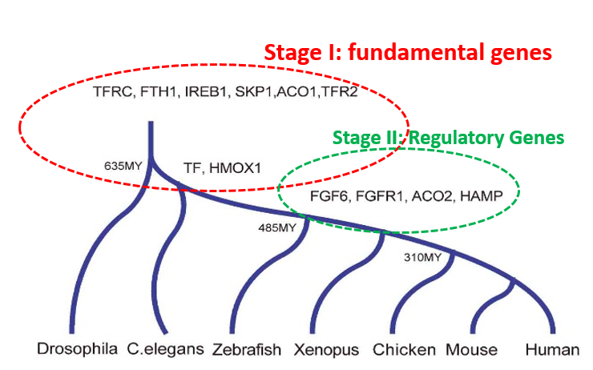
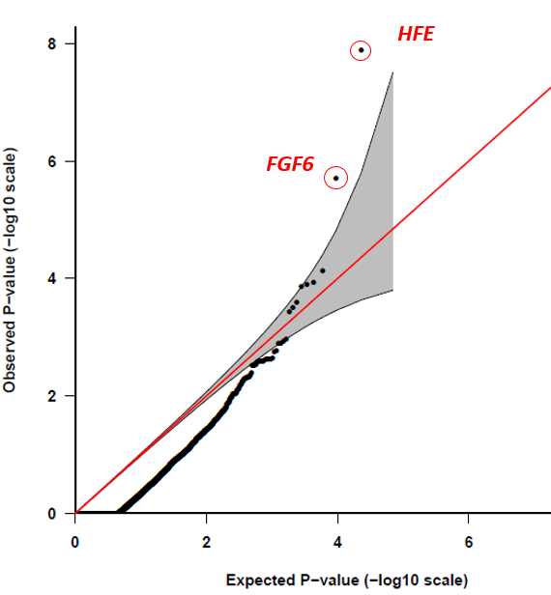
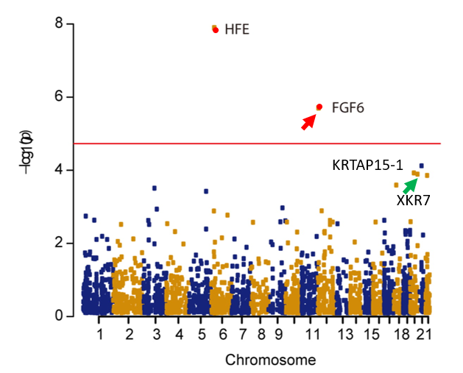
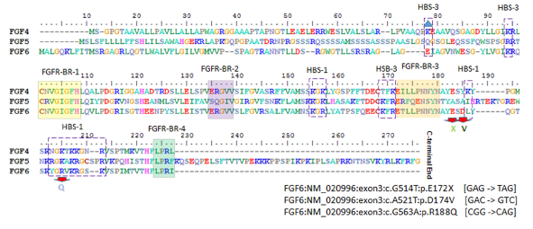
Gene-based recessive diplotype exome scan discovers FGF6 as a iron metabolism gene
PMRP: 18 HC (50% FGF6 -/-)
Fibroblast Growth Factor 6
Heparin-Binding Growth Factor 6
Guo, S. et al. A gene-based recessive diplotype exome scan discovers FGF6, a novel hepcidin-regulating iron-metabolism gene. Blood 133, 1888-1898 (2019).

Slide 8
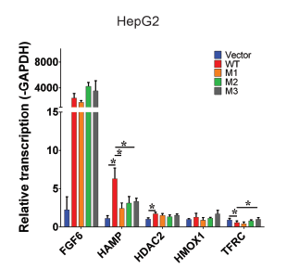
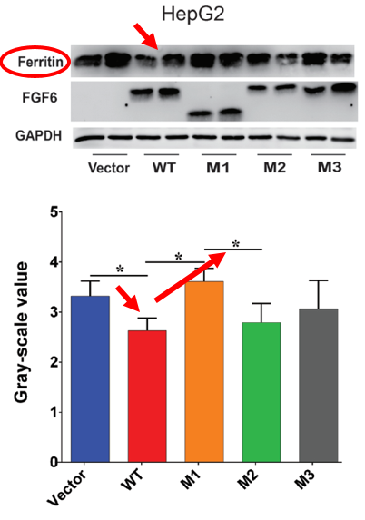
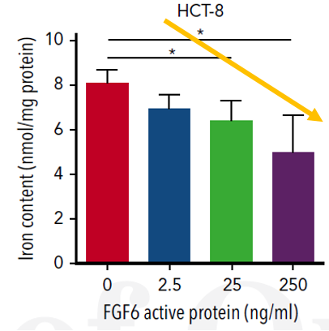
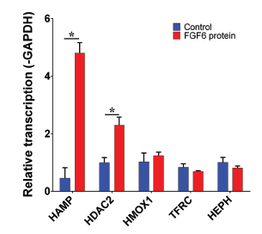
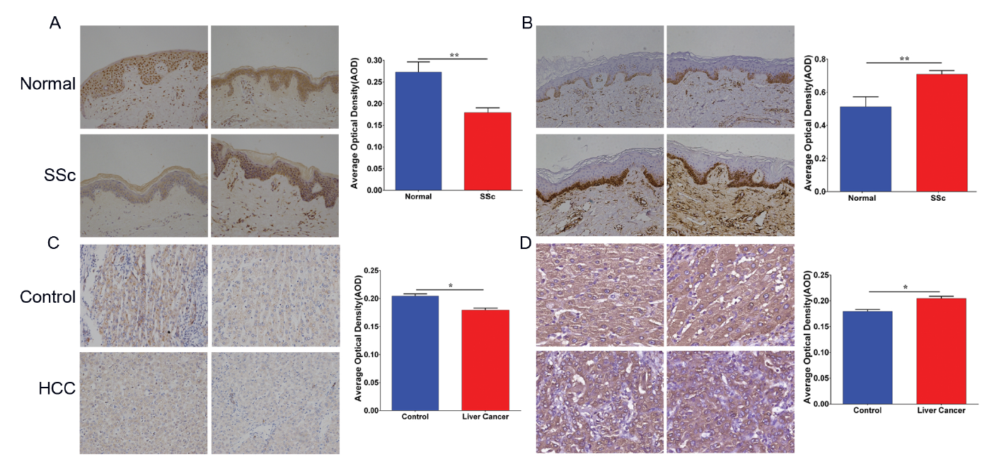
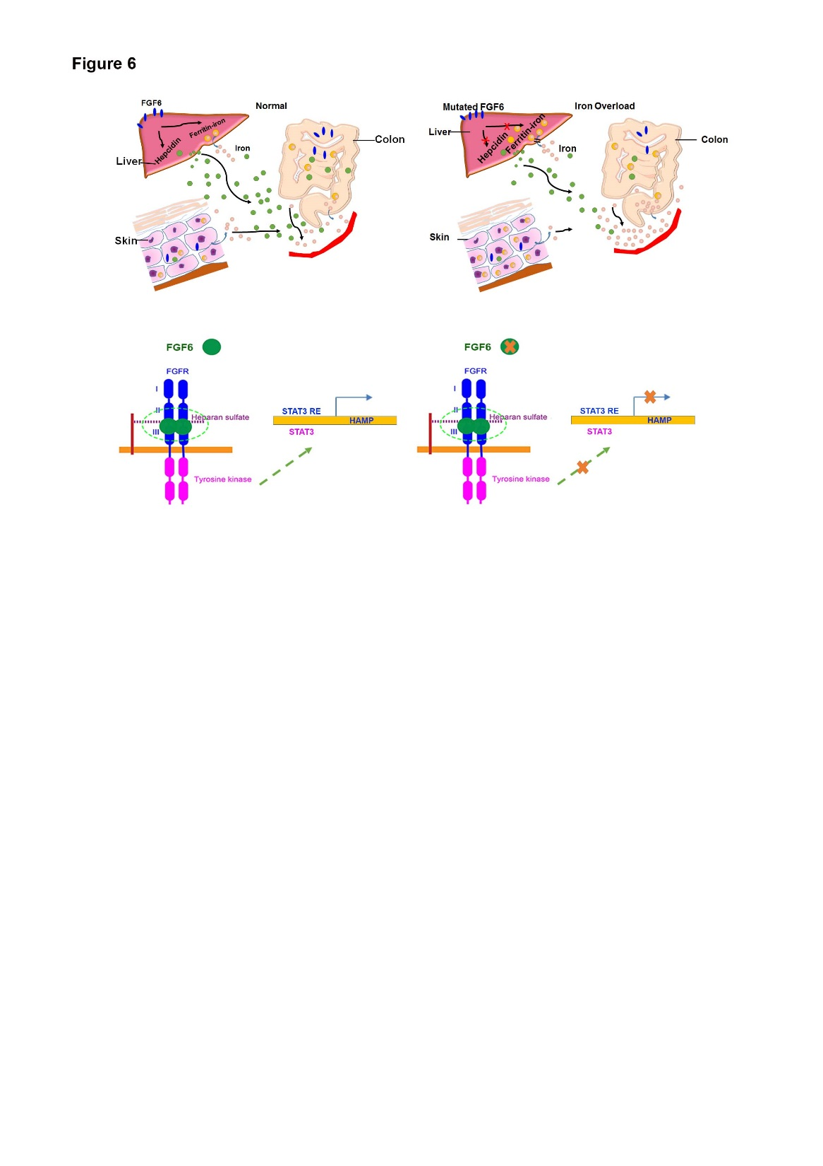
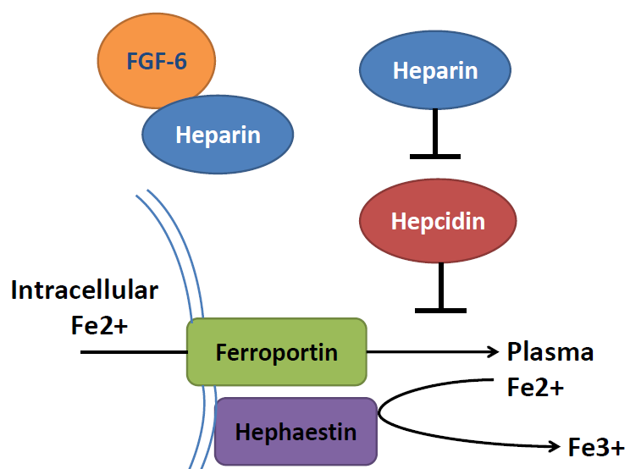
Molecular, Cellular and Immunohistochemistry to Validate FGF6 Functions
CTR
SSc
CTR
Ferrous form
HCC
Ferric form
Guo, S. et al. A gene-based recessive diplotype exome scan discovers FGF6, a novel hepcidin-regulating iron-metabolism gene. Blood 133, 1888-1898 (2019).

Slide 9
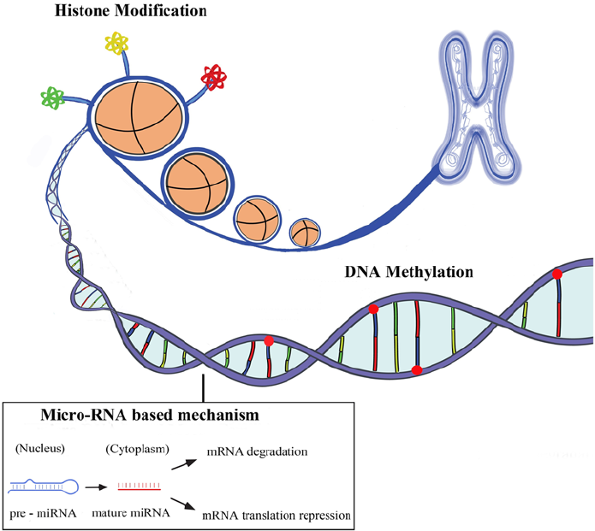
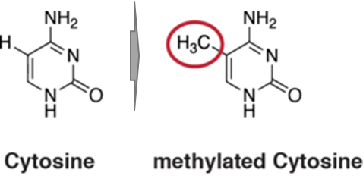
Human Genome and modification systems (Epigenetics)
DNA modification
DNA methylation
DNA hydroxymethylation
Histone modification
H3K4me1, H3K4me3
H3K27ac, H3K9ac
ncRNA system
miRNA
lncRNA
circRNA
piRNA
methyl group
Allis, Nature Review Genetics, 2016
Notes:
Our human genome is composed of A,T,C,G 4 different bases. However, human genome is not linear,

Slide 10
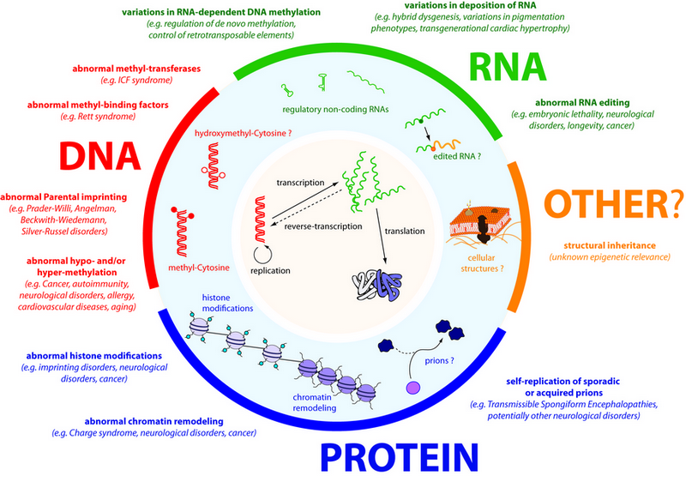
DNA methylation: powerful biomarkers for complex diseases
Almost all diseases showed abnormal methylation change
Aging can be highly predicted by methylation clock
High sensitivity: single molecular with PCR
Stable in vitro without degradation
High tissue and status specificity
Change earlier than mRNA and protein
Easy to be assembled to a multi-disease panel
Molecular biomarker, Wikipedia, 2019

Slide 11

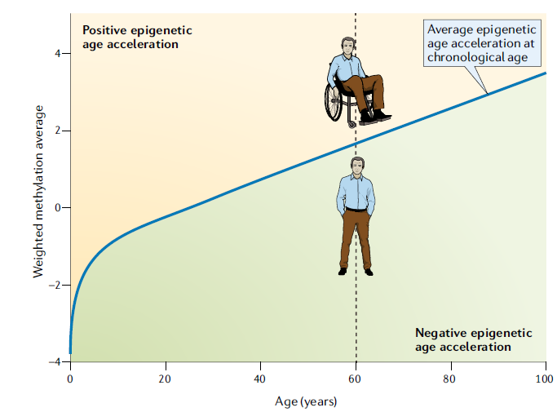
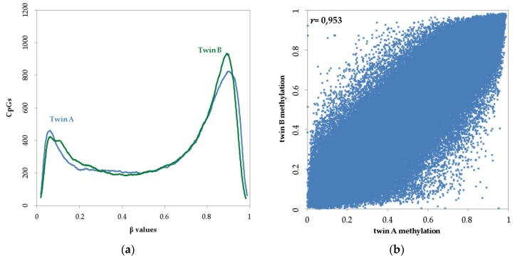
The Power of DNA methylation a biomarker
DNA ~100%
R²=0.91
DNA methylation-based age and age acceleration
Horvath, Nature Review Genetics, 2018
Guo, unpublished data
Kaminsky, Nature Genetics, 2009

Slide 12
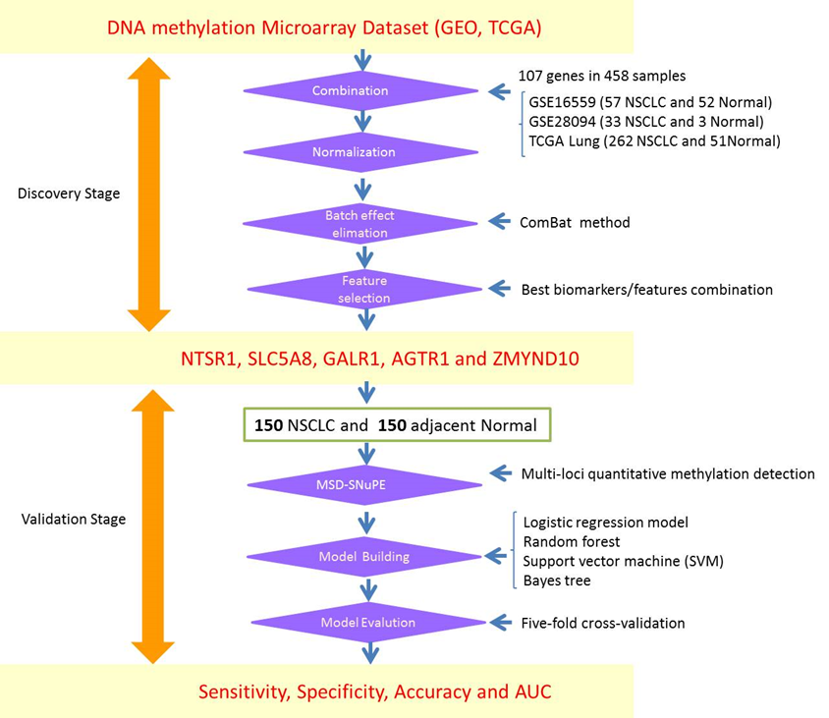
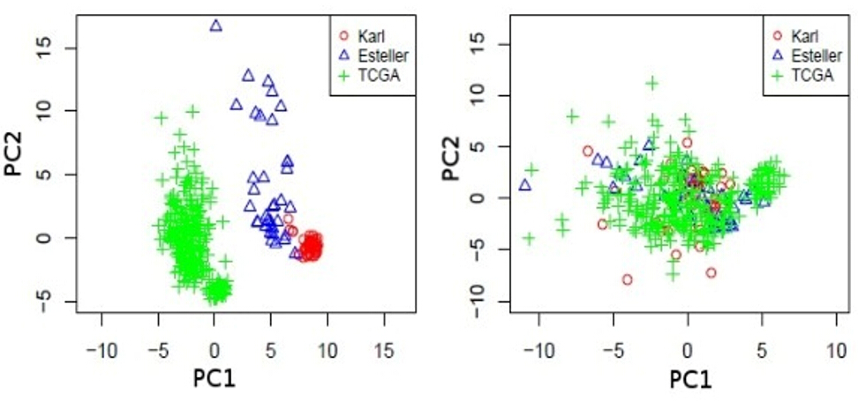
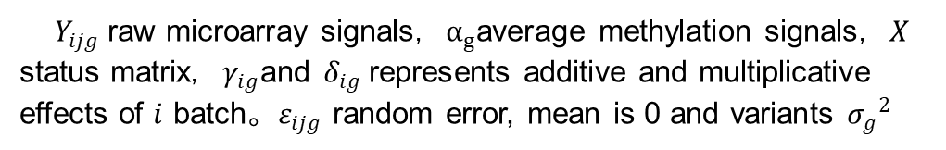
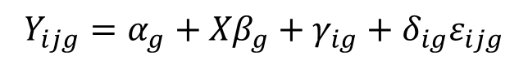
Identification and validation of the methylation biomarkers of non-small cell lung cancer (NSCLC)
$$Y_{ijg}=α_{g}+{Xβ}_{g}+γ_{ig}+δ_{ig}ε_{ijg}$$
$Y_{ijg}$ raw microarray signals，$α_{g}$average methylation signals，$X$ status matrix，$γ_{ig}$and $δ_{ig}$represents additive and multiplicative effects of $i$ batch。$ε_{ijg}$ random error, mean is 0 and variants ${σ_{g}}^{2}$
1
2
3
Guo, S et al (2015). Clin Epigenetics 7: 3

Slide 13
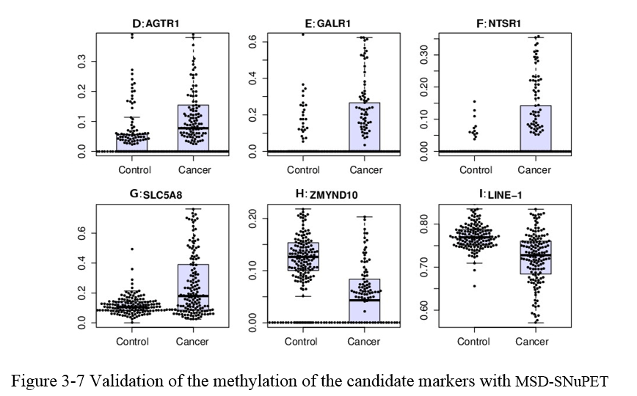
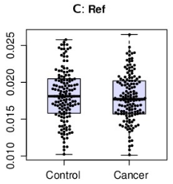
Methylation Status Determined-Single Nucleotide Primer Extension Technique (MSD-SNuPET) based Cancer Prediction
 | Train |  |  | Test
 | SEN | SPE | ACC | SEN | SPE | ACC
Logistic Reg | 0.79 | 0.99 | 0.89 | 0.78 | 0.97 | 0.87
SVM | 0.90 | 0.98 | 0.94 | 0.86 | 0.94 | 0.90
Random Forest | 0.93 | 0.93 | 0.93 | 0.89 | 0.89 | 0.89
Bayes Tree | 0.91 | 0.98 | 0.94 | 0.86 | 0.96 | 0.91
Neural Network | 0.80 | 0.90 | 0.88 | 0.75 | 0.89 | 0.80
KNN (K=2) | 0.60 | 0.95 | 0.96 | 0.71 | 0.92 | 0.79
FPCA | 0.84 | 0.96 | 0.90 | 0.82 | 0.88 | 0.84
P=0.285
 | NSCLC | CTR | Sen | Spe | AUC
AGTR1 | 12.88% | 4.48% | 59.73% | 79.59% | 0.71
GALR1 | 18.31% | 2.91% | 46.98% | 85.03% | 0.67
NTSR1 | 9.37% | 0.56% | 44.30% | 94.56% | 0.70
SLC5A8 | 25.59% | 11.66% | 52.35% | 88.44% | 0.67
ZMYND10 | 6.95% | 12.82% | 73.15% | 92.52% | 0.80
Summary:
Data integration of DNA methylation is helpful.
Batch effect is strong between different platform.
MSD-SNuPET could be applied for biomarker identification
Bayes Tree and Random Forest is powerful for prediction

Slide 14
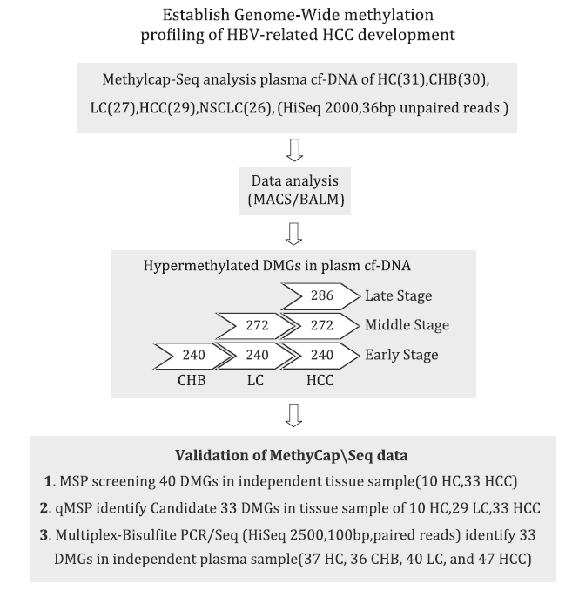
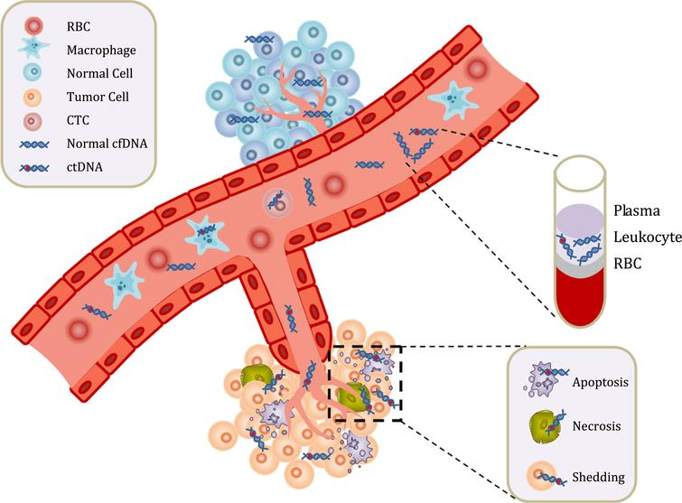
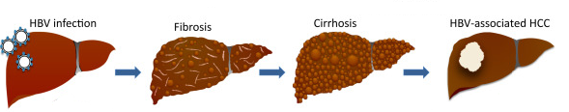
Epigenome analysis of serum cell-free circulating DNA in progression of HBV-related Hepatocellular carcinoma
HC, healthy control;
CHB, HBV-related hepatitis
LC, HBV-related liver cirrhosis;
HCC, HBV-related hepatocellular carcinoma
Process of Hepatitis B Virus-Associated Hepatocellular Carcinoma
Zhao Y, Xue F, Sun J, Guo S et al. Clin Epigenetics 2014;6(1):30. PMID: 25859288

Slide 15
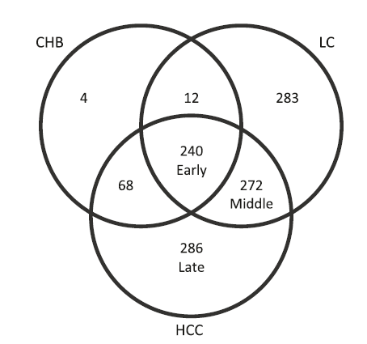
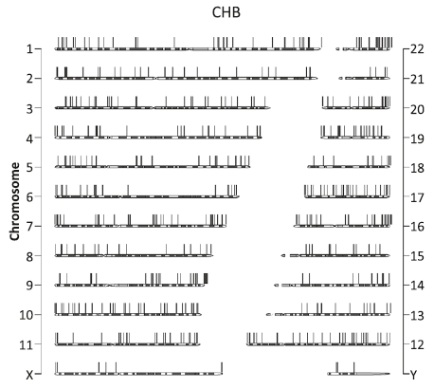
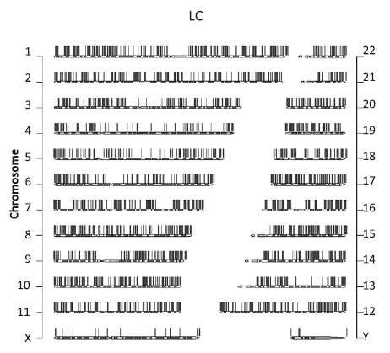
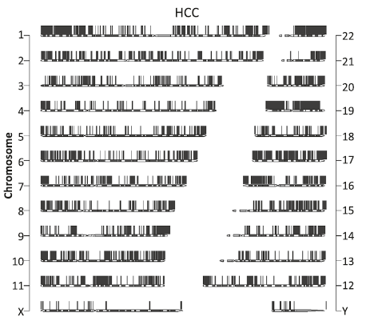
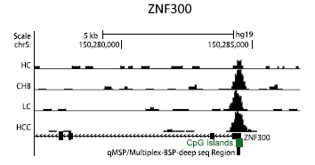
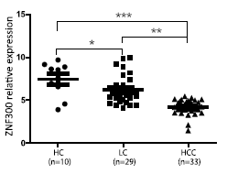
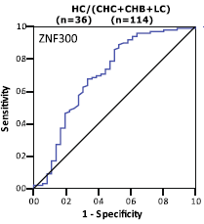
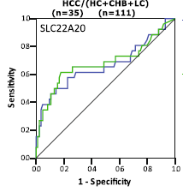
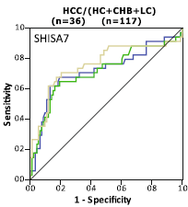
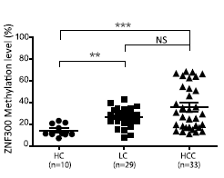
Epigenome analysis of serum cell-free circulating DNA in progression of HBV-related Hepatocellular carcinoma
HBV-related hepatitis HBV-related liver cirrhosis HBV-related HCC
AUC=0.7
AUC=0.68
AUC=0.76
Data Availability : GSE54961
Zhao Y, Xue F, Sun J, Guo S et al. Clin Epigenetics 2014;6(1):30. PMID: 25859288

Slide 16
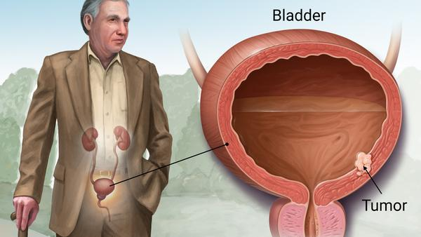
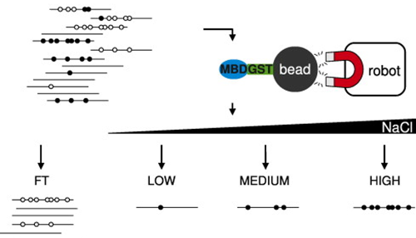
Methylcap-seq reveals novel DNA methylation markers for the diagnosis and recurrence prediction of bladder cancer
T24, 5637
BN1, BN2
BWA
Samtools
Picard
MACS2
MethylCap-Seq
BCC Normal (5637+T24) (N1+N2)
Reads(72bp) | 6,232,852 | 6,230,959
Total bases recalled | 473,696752 | 473,552,884
Base Q20 | 0.9143 | 0.909
Peaks (P<E-3) | 210,051 | 229,538
High-DMR | 70,432 | 83,690
DMR with refGene | 55,237 | 45,522
DMR with CGI | 21,179 | 1,945
DMR (refGene + CGI) | 4,256 | 401
DMR (promoter) | 1,627 | 66
Mayo Clinic Website, 2019
MBDCap-Seq/MethylCap-Seq/MBD-Seq/MBDCap/MiGS
Methods. Volume 52, Issue 3, 2010, 232-236
Zhao, Y., S. Guo, J. Sun et al. (2012). PLoS One 7(4): e35175

Slide 17
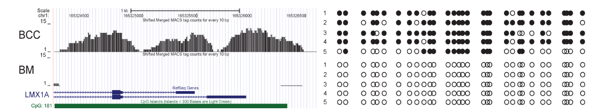
Validate Methylcap-seq library with BSP and Previous Publication
Previous Reported 21 DMR
1627 + 66 DMRs
19/21（90.5%）
22 + 2 DMRs
23 Validated
Consistency: 96%
Clinical Cancer Research 2011
Cancer EpiBiomaK Prev，2011
High quality Methylcap-seq library
8/9 validated（88.9%）
Zhao, Y., S. Guo, J. Sun et al. (2012). PLoS One 7(4): e35175

Slide 18
Validate Methylcap-seq library with BSP and Previous Publication
Most Significant
104 genes
Samples
2 Cancer cell lines
2 Normal cell lines
8 Normal tissues
 | Bladder cancer | BC vs NC (n=149) | BC vs NCL(n=41)
 | Sensitivity(%) | Specificity (%) | Specificity (%)
 | (pos./total) | (neg./total) | (neg./total)
VAX1 | 42.45(90/212) | 95.31(142/149) | 87.81(36/41)
KCNV1 | 36.92(84/212) | 93.96(140/149) | 95.12(39/41)
ECEL1 | 26.89(57/212) | 97.31(145/149) | 97.56(40/41)
TMEM26 | 26.42 (56/212) | 96.64(144/149) | 97.56(40/41)
PROX1 | 24.53(52/212) | 98.66(147/149) | 100.0(41/41)
TAL1 | 24.83(52/212) | 98.66(147/149) | 100.0(41/41)
SLC6A20 | 15.57(33/212) | 97.89(146/149) | 100.0(41/41)
LMX1 | 9.43(20/212) | 98.66(147/149) | 100.0(41/41)
CFTR | 52.35(111/212) | 96.64(144/149) | 97.56(40/41)
Panel | 88.7(188/212) | 87.3(130/149) | 85.4(35/41)
MSP assay
50%, 25.0%
49 Genes
26 samples：
8 Normal tissues
18 bladder cancers
MSP assay
17%, 12.5%
9 methylation biomarkers
VAX1
KCNV1
ECEL1
TMEM26
TAL1
PROX1
SLC6A20
LMX
Single Marker: Sensitivity: 9.4%-42.5%
402 Urine Samples：
149 Urine: Normal CTR
212 Urine: BC patients
41 Urines: noncancerous lesions
Multiple Marker: Sensitivity: 76.9%-88.7%
Multiple Marker Panel: AUC: 82%-90.0%
Zhao, Y., S. Guo, J. Sun et al. (2012). PLoS One 7(4): e35175

Slide 19
Application of DNA methylation Panel in Diagnosis and Surgery Evaluation
48 suspected bladder cancer patients
26 Confirmed BCC
Cystoscopy
Methylation Panel
32 BCC
16 non-BCC
21 Methylation Positive Patients
Methylation Panel
Bladder Cancer Remove Surgery
25 BCC
SEN=78.1%
14 non-BCC
SPE=87.5%
19 Negative
2 Positive
P<0.0001
24 month Follow-Up
Surgery Success Ratio：91%
Lost Follow-Up
1/2 individuals diagnosis as BCC
Zhao, Y., S. Guo, J. Sun et al. (2012). PLoS One 7(4): e35175

Slide 20
Cell-free Circulating Tumor DNA (ctDNA) in human Carcinoma
ctDNA 10-200ng/ul Plasma
Non-random distributed, repeat regions
Non-invasive diagnosis and real-time surveillance
Circulating tumor DNA, Wikipedia, 2019

Slide 21




Methylation Haplotype and Methylation Haplotype Load
l: length of haplotype
$w_{i}=i$ or $w_{i}=i^{2}$
Methylation level and pattern of co-methylation (complexity)
Guo, 2017, Nature Genetics

Slide 22

Tissue clustering based on cell-free circulating DNA methylation
Endoderm Mesoderm Ectoderm
Unsupervised clustering of human tissues using the top 15% most-variable regions from WGBS
We identified numerous germ-layer-specific methylation markers
Guo, Nature Genetics, 2017

Slide 23


Tissue specific hyper-methylation MHB regions show tissue specificity
MHL

Slide 24


Performance of tissue-specific MHL based tissue-of-origin mapping
Sensitivity: 87.9%
Sensitivity: 87.6%
Specificity: 90.2%

Slide 25



Unsupervised cluster analysis reveals cancer and normal similarity
Distance= 1-correlation
Cluster= mcquity
Pan-cancer methylation microarray dataset
11 cancer types
349,049（CpGs）$×$1278（Samples）
Guo, unpublished data

Slide 26


Tumor heterogeneity revealed by genome-wide DNA methylation
Lung Cancer R=0.90
KIRC and KIRP
Kidney Clear Cell Carcinoma
Kidney Papillary Cell Carcinoma
Liver Cancer R=0.84
Kidney
R=0.97
KIRC/KIRP R=0.92
LUAD UCEC COAD LUSC KIRP LIHC PRAD HNSC THCA BRCA KIRC
Cancer samples
Normal samples
Guo, unpublished data

Slide 27


Multi-label Classification to Pan-cancer with Random Forest Method
 | Variable=25 |  |  | Variable=75
 | Sen | Spe | Acc | Sen | Spe | Acc
BRCA | 0.85 | 0.97 | 0.91 | 0.94 | 1.00 | 0.97
COAD | 0.72 | 0.85 | 0.78 | 0.92 | 0.89 | 0.91
HNSC | 0.58 | 0.72 | 0.65 | 0.94 | 0.90 | 0.92
KIRC | 0.99 | 1.00 | 0.99 | 0.99 | 1.00 | 0.99
KIRP | 0.84 | 1.00 | 0.92 | 0.91 | 1.00 | 0.96
LIHC | 0.87 | 0.96 | 0.92 | 0.92 | 0.98 | 0.95
LUAD | 0.27 | 0.73 | 0.50 | 0.58 | 0.85 | 0.71
LUSC | 0.63 | 0.93 | 0.78 | 0.78 | 0.93 | 0.85
PRAD | 0.78 | 0.82 | 0.80 | 0.86 | 0.84 | 0.85
THCA | 0.79 | 0.88 | 0.83 | 0.88 | 0.96 | 0.92
UCEC | 0.57 | 0.77 | 0.67 | 0.77 | 0.97 | 0.87
25-75 CpGs provide ~80% accuracy to 22 sample types
Guo, unpublished data

Slide 28

Cell-free DNA Methylation reveals Liver Disease Status
Long-region average methylation level from low-pass genome-wide DNA methylation sequencing data
2 Mbp Genome-window
Guo, unpublished data

Slide 29


Cancer diagnosis panels to be validated in the plasma using cell-free DNA methylation
GBM: IRF4, MGMT, CD133, ARF1,C2orf40,
NULL
BRCA
COAD
GBM
HCC
KIRC
LUAD
LUSC
PRAD
UCEC
PBMC
B-cells
Neutrophil
CD4+
CRC
AML
BML
GBM
BCRA
HepG2
NSLCL
RA
OA
Brain
TCGA+GEO: 11846 cancer samples
Support vector machine (five-fold cross-validation)
Guo, unpublished data

Slide 30



Long History of Precision Medicine of Marshfield Clinic
EHR
Precision Medicine initiative (PMI)
1960
ICD-9
2007
2019
1916
1990
2015
ICD-10
eMERGE Network
CPMR
Notes:
https://en.wikipedia.org/wiki/Marshfield_Clinic

Slide 31


Slide 32

Informatics Strategy: Key to Precision Medicine Success
Genetic risk factors (w_{i})
Clinical Phenotypes
Weeks
Years
Image phenotypes (w_{x})
Pathological phenotypes (w_{u})
Environmental risk factors (w_{j})
Epigenetics risk factors (w_{p})
Non-Supervised Machine-Learning
Neural Network based Deep-Learning
Lifestyle risk factors (w_{q})

Slide 33


Big Data: The Key to Reveal Disease Heterogeneity / Subtypes
Anti-CCP
RF-IGG
ESR
CRP
RF-IGA
RF-IGM
Unpublished data, Guo, 2019

Slide 34




Acknowledgements
Dr. Li Jin
Fudan University
Dr. Momiao Xiong
University of Texas
Dr. Kun Zhang
UCSD
Dr. Steven Schrodi
MCRI
2009-2015
2013-2015
2015-2017
2017-2019
Shanghai, China Houston, TX San Diego, CA Marshfield, WI

Slide 35
Dr. Shicheng Guo
Guo.Shicheng@marshfieldresearch.org

Slide 38

Neural Network based Deep Learning in Human Genetic Data
SRY and ATL1

Slide 39


Slide 40


Rochester Epidemiology Project (REP)
MCRI Scientific Seminar: 02/08/2019
REP DEP from Mayo Clinic

Slide 41








Acknowledgements
Brent Olson, MRCI
Terrie Kitchner, MCRI
Jeffrey Joyce, MCRI
Robert Strenn, MCRI
Dr. Joseph J. Mazza Dr. Jennifer K. Meece
Dr. Naren Epperla, OSU
Dr. Judy Smith

Slide 42


Slide 43
• 98% of patients have genetic variants that affect how well they do (or don’t) metabolize specific medications – or if the drug might have toxic effects¹ • 34% of all adverse drug reactions are caused by genetics, not drug-drug interactions²

Slide 44


Slide 45


Slide 46

Precision medicine to common disease and rare disease
Published: 08 May 2019

Slide 47
How to Dismantle Obstacle on the Way to Precision Medicine
SNPs
CNV
Mutation
DNA methylation
RNA-seq
miRNA-seq
Bioinformatics
Clinical informatics
Image informatics
Pathology Informatics
Public health informatics
X-ray radiography
Magnetic resonance image
Notes:
Doing research is good, however, nobody want to take the risk to be the jail or life to do such research.

Slide 48

DNA methylation, gene expression and human development
DNA methylation, Wikipedia, 2019

Slide 49



Future work
US, FDA
US20070048738A1
Prostate cancer
Glioblastoma cancer
Pancreatic cancer
Chronic lymphocytic leukemia

Slide 51
GSE103659: 181 GBM with 450K
GSE114534: 44 GBM with 450K
GSE66351: 190 normal brain with 450K
GSE41826: 58 normal brain with 450K
GSE89707: 142 normal brain with 450K
GSE74486: 131 brain from Trisomy 21 causes Down syndrome with 450K
GSE36194: 724 Normal brain with 27K
GSE53229 : 145 GBM with 27K
GSE50923: 54 GBM+23 control brain with 27K
GSE46015: 3 GBM, each sample have two replicates with 27K
GSE22867: 55 GBM + 3 normal with 27K
GSE119774: 39 GBM, 41 GSC, 9 NSC with 850K
GSE116298: 12 GBM, each sample have 3 replicates with 850K

Slide 52


Low cost
High stability
Mature analysis
Low DNA requirement
Bigdata support
MethylCap-Seq
MBD-Seq
MeDIP-seq
RRBS
Bisulfite-Seq

Slide 53

Two families of proteins that bind methylated DNA
Chromosoma. 2009 Oct; 118(5): 549–565
Notes:
Two families of proteins that bind methylated DNA. a Methyl-CpG binding proteins (MBDs): MBD proteins display homology within their MBD domains, while the transcription repression domains (TRD) described for MeCP2, MBD1, and MBD2 are non-homologous. In addition to its MBD domain, MBD1 is able to bind unmethylated DNA via its third CxxC zinc-finger motif. MBD2 features a characteristic stretch of glycine and arginine residues (GR) and has juxtaposed MBD and TRD domains. MBD3 is, due to a mutation in the MBD domain, not able to bind methylated CpGs in mammals. MBD4, a thymine glycosylase, contains a C-terminal glycosylase domain used for excision-based DNA repair. b Kaiso protein family: three members of the Kaiso protein family have been described so far. Kaiso, ZBTB4, and ZBTB38 share a triple zinc-finger domain and a BTB/POZ domain which in case of ZBTB4 contains a 60 amino acid insertion. Furthermore, ZBTB4 and ZBTB38 contain respectively three and seven additional zinc-fingers

Slide 54
Biochemical interactions of methyl CpG binding proteins
Protein | Interacting partner | Effects of the interaction | Reference
MeCP2 | Sin3A, HDACs | Transcriptional repression | Jones et al. (1998), Nan et al. (1998)
 | c-ski, N-CoR | Transcriptional repression | Kokura et al. (2001)
 | HMGB1 | Unknown | Dintilhac and Bernues (2002)
 | Sin3B, HDAC2 | Transcriptional repression | Rietveld et al. (2002)
 | Dnmt1 | Targeting of maintenance DNA methylation? | Kimura and Shiota (2003)
 | H3K9 methyltransferase | Transcriptional repression | Fuks et al. (2003b)
 | CoREST complex | Repression of neural genes | Ballas et al. (2005), Lunyak et al. (2002)
 | Brm (SWI/SNF complex) | Transcriptional repression | Harikrishnan et al. (2005), Hu et al. (2006)
 | YB-1 | Alternative splicing | Young et al. (2005)
 | ATRX | Epigenetic regulation required for neural development | Nan et al. (2007)
 | HP1 | Transcriptional repression during myogenic differentiation | Agarwal et al. (2007)
 | CREB1 | Transcriptional activation | Chahrour et al. (2008)
MBD1 | MPG | DNA repair | Watanabe et al. (2003)
 | Suv39h1-HP1 | Transcriptional repression | Fujita et al. (2003)
 | MCAF1, MCAF2, SETDB1, CAF-1 p150 | Transcriptional repressioinheritance of epigenetic states | Ichimura et al. (2005), Reese et al. (2003), Sarraf and Stancheva (2004)
 | PML-RARα, HDAC3 | PML-RARα-mediated silencing | Villa et al. (2006)
MBD2 | Mi-2, MTA1-3, P66α/β, HDAC1/2, RbAp46/48, DOC-1, PRMT5, MEP50 (NuRD complex) | Transcriptional repression | Brackertz et al. (2002), Le Guezennec et al. (2006), Zhang et al. (1999)
 | Sin3A | Transcriptional repression | Boeke et al. (2000)
 | Tax | Transcriptional activation | Ego et al. (2005)
 | TACC3, HATs, pCAF | Transcriptional activation | Angrisano et al. (2006)
 | GCNF | Oct-4 silencing | Gu et al. (2006)
 | Dnmt1 | Targeting of maintenance DNA methylation? | Tatematsu et al. (2000)
 | RFP | Enhancement of transcriptional repression | Fukushige et al. (2006)
MBD3 | Mi-2, MTA1-3, P66α/β, HDAC1/2, RbAp46/48, DOC-1 (NuRD complex) | Transcriptional repression | Le Guezennec et al. (2006), Wade et al. (1999), Zhang et al. (1999)
 | Dnmt1 | Targeting of maintenance DNA methylation? | Tatematsu et al. (2000)
 | CDK2AP1, GCNF | Oct-4 silencing | Deshpande et al. (2009), Gu et al. (2006)
MBD4 | Sin3A, HDAC1 | Transcriptional repression | Kondo et al. (2005)
 | FADD | Genome surveillance/apoptosis? | Screaton et al. (2003)
 | MLH1 | DNA repair | Bellacosa et al. (1999)
 | RFP | Enhancement of transcriptional repression | Fukushige et al. (2006)
Kaiso | Tcf3 | Suppression of Wnt signaling | Ruzov et al. (2009)
 | p120 | Wnt signaling? | Daniel and Reynolds (1999), Prokhortchouk et al. (2001)
 | N-CoR | Transcriptional repression | Yoon et al. (2003)
Chromosoma. 2009 Oct; 118(5): 549–565
Notes:
Chromosoma. 2009 Oct; 118(5): 549–565.

